Slide 1

4TH
4TH OFFICIAL
Game Duties &
Professional Standards
Pre-Game Preparation · Bench Management · Disciplinary Protocols
OFFICIAL · IMPARTIAL · PROFESSIONAL

Slide 2
PRE-GAME SETUP
1
Dress the Part
Walk the field and dress appropriately. You are part of the officiating team — look and act like it.
2
Timekeeping
Identify the timekeeper and the substitution tracker. Personally instruct the timekeeper on exactly when the clock stops and when it should restart.
3
Coach Introductions
Introduce yourself to both coaches. Spend equal time with each. DO NOT embrace either one — you must appear completely impartial. If a head coach is in warmups, choose a moment that does not disrupt them.

Slide 3
BENCH MANAGEMENT
4
Control the Bench
Politely ask coaches to control their benches. Players must remain in designated areas (NCAA). Players warming up must wear pinnies and not engage with opponents.
5
Assist in Game Management
Handle coaches and benches in a calm, respectful, and professional manner. Assist the referee with overall game management.
6
Coach Conduct
Remind coaching staff to behave responsibly. They must NOT enter the field to protest a decision. Do NOT ball-watch — keep your attention on the bench.

Slide 4
WHEN · WHERE · WHAT TO WATCH
Players Flaring Up
Controversial Calls
Alert the assistant coach immediately when tensions rise between players on or near the bench.
On penalties, yellow/red cards, or offsides — turn your attention to the bench opposing the decision. Move in that direction.
Continued Dissent
Talk First
If dissent continues after your presence, take action. Provide clear information to the center referee on any 110% clear YC or RC.
Try speaking directly to offenders first. If the behavior continues, summon the referee. Bench players may celebrate a goal — this is permitted.

Slide 5
WHEN TO TAKE ACTION
After ONE warning to coaching staff — summon the referee and identify the offender.
Give the referee a recommendation on who should be cautioned, including the correct player number.
Trainers & bench personnel not behaving responsibly → summon the referee and request dismissal.
Any bench personnel who enters the field of play to dissent a decision MUST be sent off.
Head coach asks a respectful question? Provide a brief, pertinent response — that's appropriate.
⚠️ If you must reprimand bench personnel MORE THAN ONCE — you are not doing your job.

Slide 6
CORE PRINCIPLES
IMPARTIAL
Spend equal time with both teams. Never show allegiance to either side through words, body language, or engagement.
CALM
Handle every situation with composure. A calm, steady presence de-escalates tension before it becomes a problem.
DECISIVE
Once a warning is given, follow through. Indecision emboldens offenders and undermines match control.
PROFESSIONAL
You represent the officiating crew. Dress, communicate, and conduct yourself at the highest standard — always.
OFFICIAL · IMPARTIAL · PROFESSIONAL

Slide 7
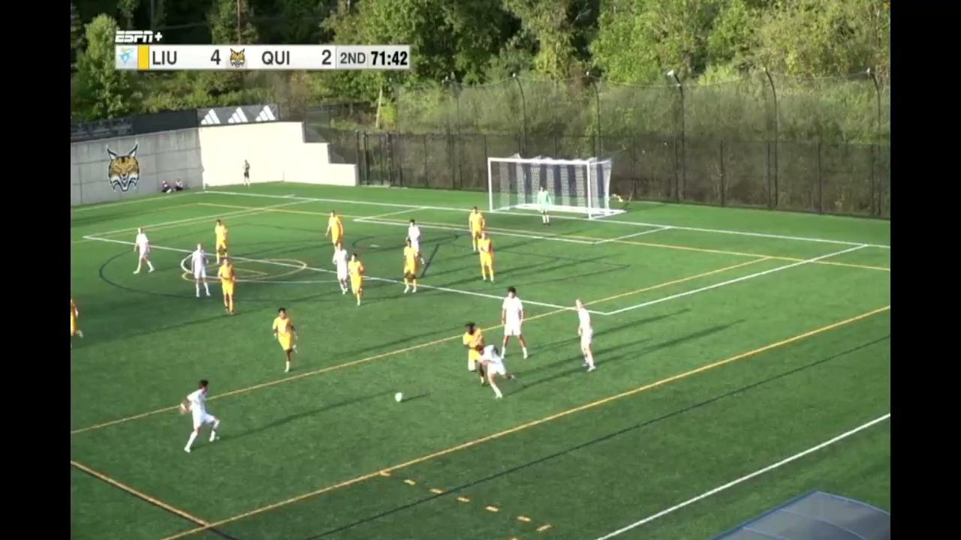
Notes:
This game doesn’t appear to have had a 4th Official. With a 4th and if comms, can the 4th Official be indicating a foul sooner? What is the 4th Officials’ role in the mass confrontation right in front of the benches?

Slide 8
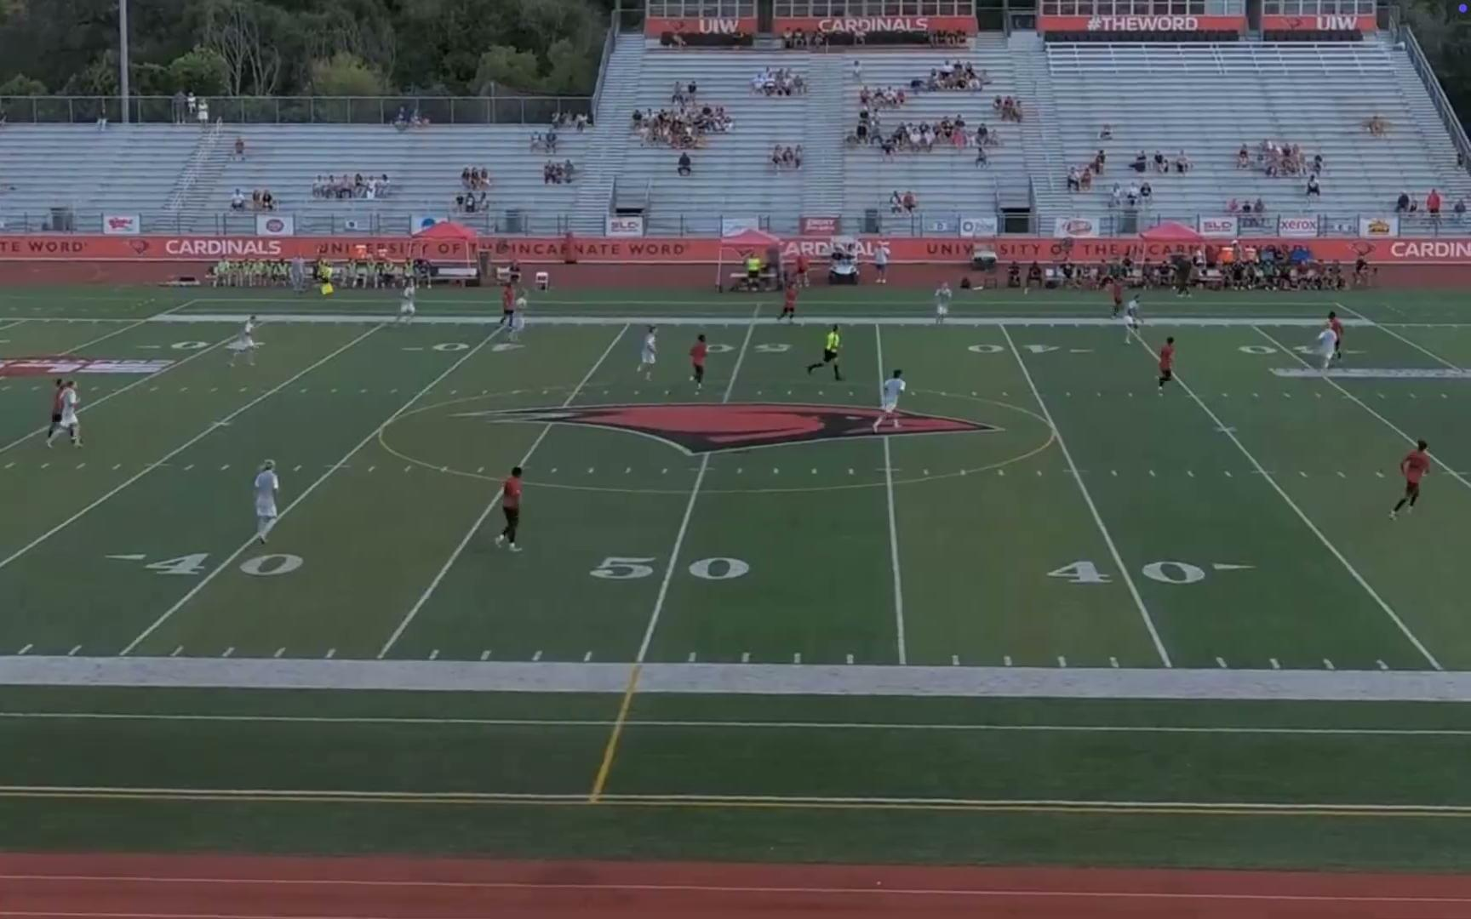
Notes:
AR needs to see this. Can 4th Official be scanning the field and catch this too?

Slide 9
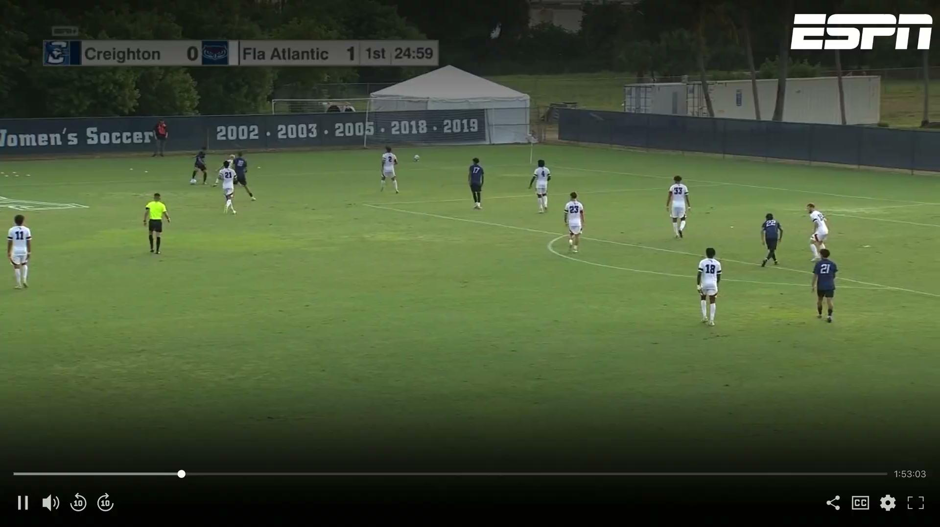
Notes:
Not a good second yellow card. Anticipate that there may be dissent. Can the 4th Official help the Referee? Or, does the 4th Official simply need to confirm the decision on the field and attempt to quell the dissent and refocus the coach/bench on the game?

Slide 10
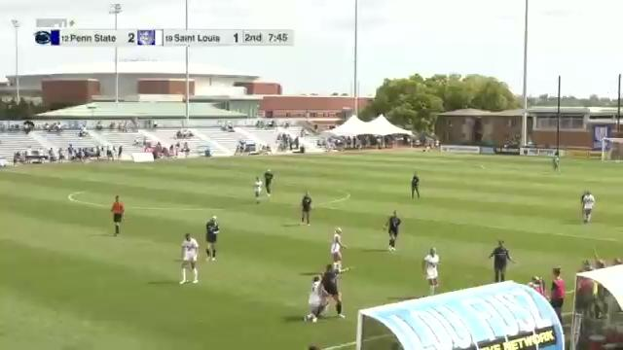
Notes:
4th Official alerts the Referee to coach dissent on the sideline

Slide 11
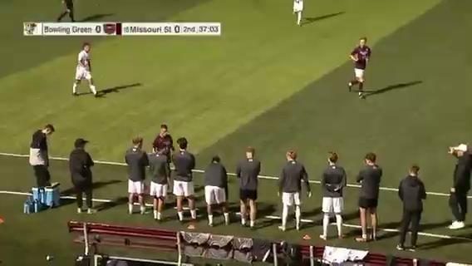

Slide 12
